Slide 1

Reactive, Concurrent,
Asynchronous
carlos.hernandez@liferay.com

Slide 2
What is Reactive Programming?!
Understanding the kind of problems that reactive programming solves

Slide 3
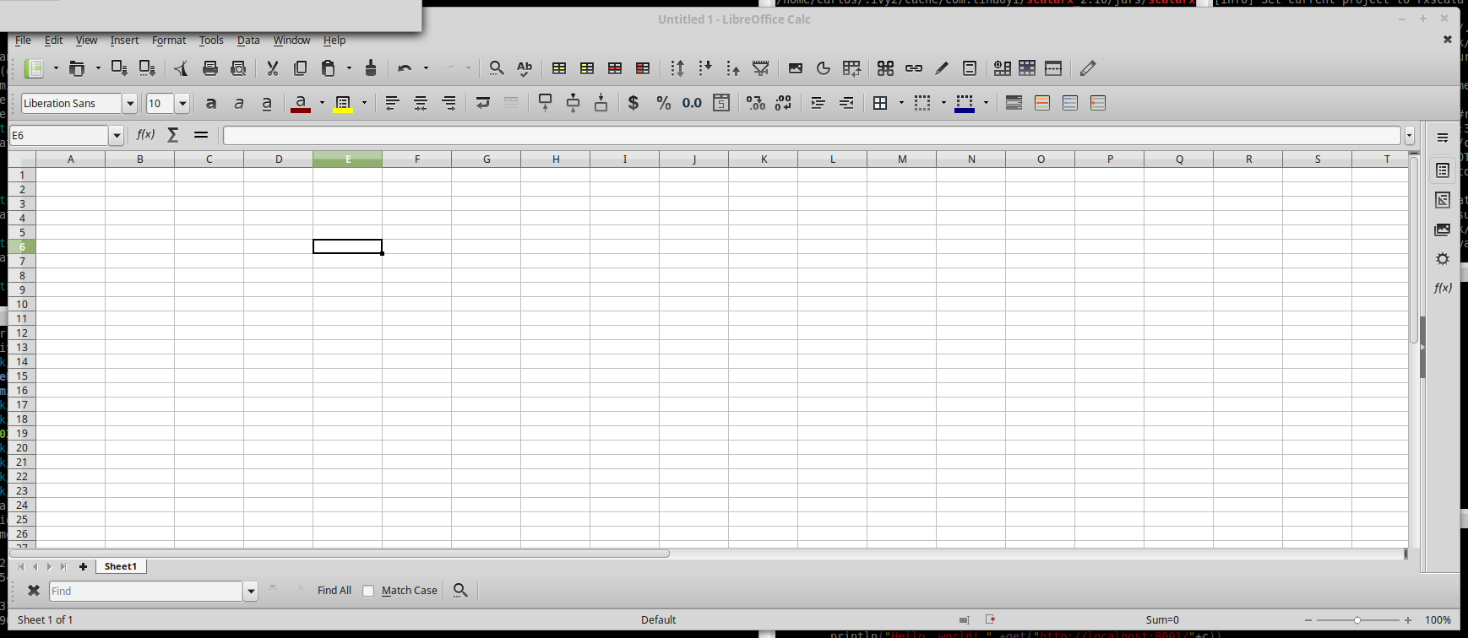
Example: Modern Spreadsheet
MVC applications where if you update a model, the view is automatically updated, would be another example of reactive applications.
Microsoft released the first version of Excel for the Macintosh on September 30, 1985, and then ported it to Windows.

Slide 4
First example
a=2 b=3
a=3
c=???
c=a+b
c=5

Slide 5
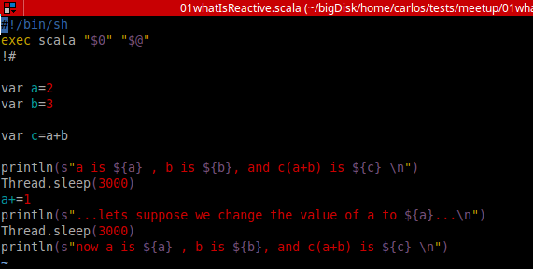
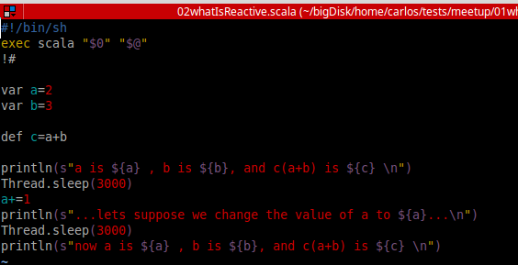
First example

Slide 6

Propagation of change
In computing, reactive programming is a programming paradigm oriented around data flows and the propagation of change.
Reactive programming - Wikipedia, the free encyclopedia

Slide 7
Variables depend on other variables
USD-KRW -> 8.7095244E-4 USD-RON -> 0.24678175 USD-ZAR -> 0.06900184 USD-BRL -> 0.30826715 USD-TRY -> 0.34500062 USD-IDR -> 7.635728E-5 USD-MXN -> 0.054533616 USD-CNY -> 0.15004918 USD-RUB -> 0.015684785 USD-MYR -> 0.25052297 USD-HKD -> 0.1288852 USD-NZD -> 0.72081286 USD-NOK -> 0.120361365 USD-AUD -> 0.7529746 USD-PLN -> 0.25139943 USD-ILS -> 0.25953025 USD-CZK -> 0.04110722 USD-CAD -> 0.777359 USD-CHF -> 1.0275856
RUB-KRW-> ???
RUB-ZAR -> ???
RUB-BRL -> ???
RUB-AUD -> ???
RUB-IDR -> ???
RUB-INR -> ???
RUB-RON -> ???
RUB-USD -> ???
RUB-SGD -> ???
RUB-CZK -> ???
RUB-CNY -> ???
RUB-HKD -> ???
RUB-HRK -> ???
RUB-CHF -> ???
RUB-SEK -> ???
RUB-DKK -> ???
RUB-PHP -> ???
RUB-PLN -> ???
RUB-BGN -> ???
MYR-KRW -> ???
MYR-ZAR -> ???
MYR-BRL -> ???
MYR-AUD -> ???
MYR-IDR -> ???
MYR-INR -> ???
MYR-RON -> ???
MYR-USD -> ???
MYR-SGD -> ???
MYR-CZK -> ???
MYR-CNY -> ???
MYR-HKD -> ???
MYR-HRK -> ???
MYR-CHF -> ???
MYR-SEK -> ???
MYR-DKK -> ???
MYR-PHP -> ???
MYR-PLN -> ???
MYR-BGN -> ???
RUB-KRW = USD-RUB / USD-KRW

Slide 8
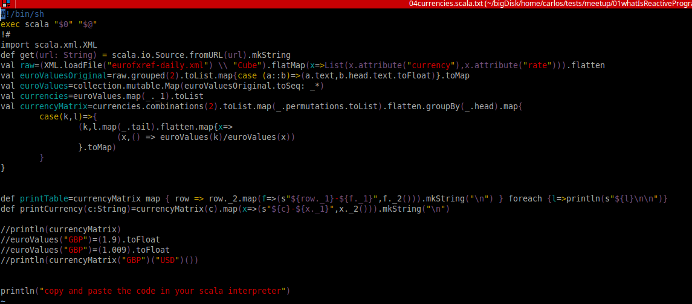
Example 4, list of list of functions

Slide 9
Ideas
Second example
Functional approach
Q-Is it really reactive?
A-Probably not, but… what do we care?

Slide 10
Definition for Reactive Programming?
Reactive programming is programming with asynchronous data streams Source: https://gist.github.com/staltz/868e7e9bc2a7b8c1f754
These data streams could be anything, not just click and hover events. Streams are cheap and ubiquitous, anything can be a stream: variables, user inputs, properties, caches, data structures, etc.
A stream is a sequence of ongoing events ordered in time. It can emit a value (of some type), an error, or a "completed" signal.
We capture these emitted events only asynchronously (callbacks, Observer Design Pattern).

Slide 11
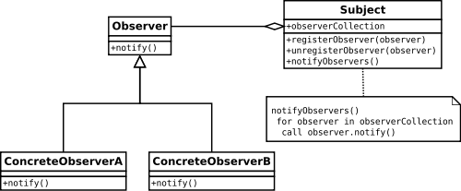
The “Observer” design pattern
Drawbacks: Memory leaks risk, explicit registration and deregistration, or use of weak references.

Slide 12
Using a framework
https://github.com/lihaoyi/scala.rx
import rx._
(see examples)

Slide 13
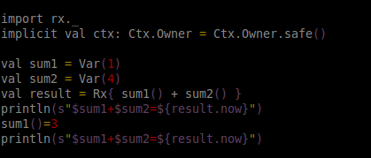
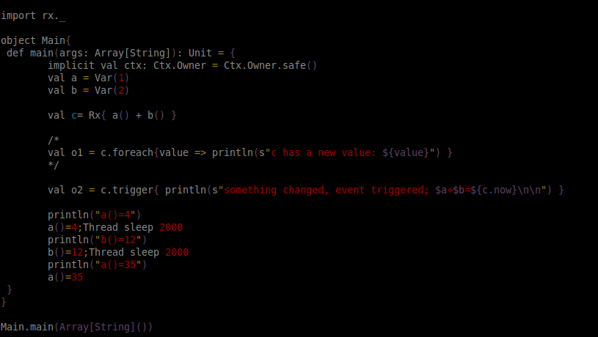
Using a framework

Slide 14
Some thoughts on Asynchrony
Why is it so important?

Slide 15
Asynchrony
Example:
Let’s compare nodejs (javascript) with java or scala (we won’t show the code, just the execution)

Slide 16
Asynchrony
Great, then why don’t we run everything asynchronously and forget about it?
Because not everything can be Asynchronous!!! We need some coordination.

Slide 17
Problem->Solution->New problems
Welcome to the concurrent programing world!! The world of deadlocks and race conditions, where programs are hard to debug and never work the first time you write them and you don’t know why

Slide 18
…->New problems->New Solutions...
We need high level synchronization mechanisms that make our life easier! Keep reading...

Slide 19
Futures and Promises
What are they used for? Wow are they used?

Slide 20
Concurrency primitives are too low level
Java's low-level concurrency primitives (synchronized,volatile, wait(), notify(), and notifyAll()) aren't easy to use correctly. Threading hazards like deadlock, thread starvation, and race conditions, which result from incorrect use of primitives, are also hard to detect and debug.
Java's basic threading capabilities are too low level. Developers often need higher level constructs that end up building themselves which is both time consuming and error prone.
source: http://www.javaworld.com/article/2078809/java-concurrency/java-concurrency-java-101-the-next-generation-java-concurrency-without-the-pain-part-1.html

Slide 21
Futures and Callables
The executor framework works with Runnable objects.
A Runnable cannot return a result to the caller.
But
The java.util.concurrent.Callable object can.
The Callable object uses generics to define the type of object which is returned.

Slide 22
Before Java8
Java Futures do not provide the option to register a callback method.
Future<String> f1 = download(new URL("http://example.com"));
while (!f1.isDone()) {
askUserToWait();
doSomeComputationInTheMeantime();
}
f1.get();

Slide 23
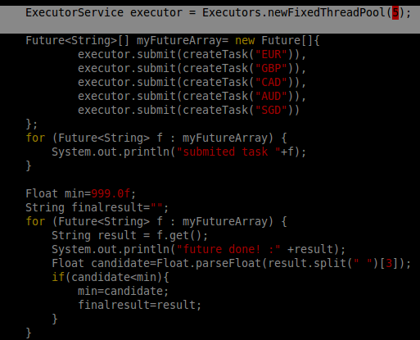
Example1, Futures and Loops
we get blocked when retrieving the results (even thought the execution happens in parallel)

Slide 24
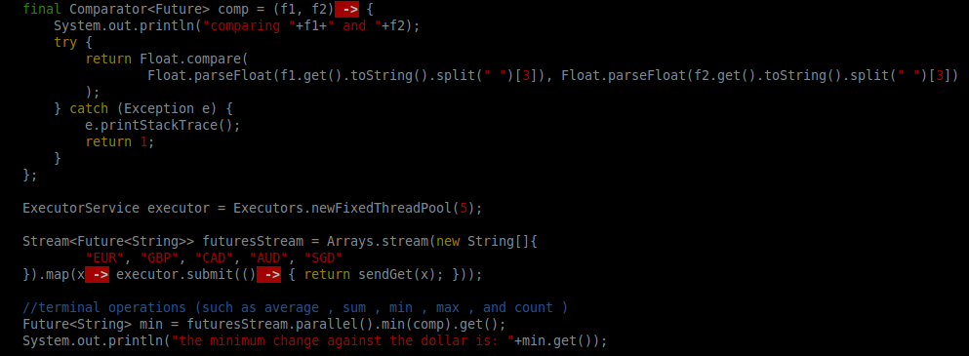
Example2, Streams and Futures in Java8
We create a parallel stream, each future works independently and there is a compare function that gets blocked and unblocks itself every time the two futures it is comparing return a value.

Slide 25
Callbacks?
Future does not provide the option to register a callback method.
What can we do?
Java 5 -> ExecutorCompletionService Wraps ExecutorService and "remembers" all submitted tasks.
It allows you to wait for the first completed (key point -see examples 1 and 2-).
Java 8 -> CompletableFuture interface

Slide 26
Completable Futures
CompletableFuture<String>myCompletableFuture=CompletableFuture.supplyAsync(() ->...) //we continue, we do not stop here myCompletableFuture.thenAccept( result -> System.out.println("task finished "+result)); … ... //now we block System.out.println("Done!!"+myCompletableFuture.get());

Slide 27
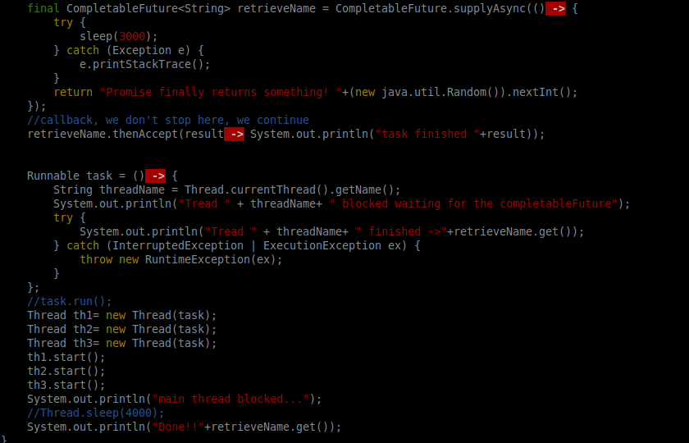
We create a completable future , then we create a callback and continue
Then we create three threads that get blocked waiting for the future’s result, when the results finishes, the callback is triggered and the threads continue their execution

Slide 28
Chaining Futures (callback within a callback)
CompletableFuture<Void> future = fetchPerson(id).thenCompose(person -> { return fetchCompany(person.getCompanyId()).thenAccept(company -> { // Now we have a reference to both objects. }); }); // You can continue doing things and not worry; your callbacks will be executed.

Slide 29
Futures in Scala
Futures in Scala do have callbacks
Success(t:T)
Failure(t:Throwable)
f.onComplete, f.onSuccess, f.onFailure
Scala’s concurrency model is built on top of Java’s
and makes them a little bit more human friendly

Slide 30
Leverage the power of functional programming
map
val myFutureOfAList2 = Future(List(1,2,3)).map(_.map(_+1)) Future[List[Int]] => Future[List[Int]]
Monads?
flatMap
Future(getTime(“http://timeService.com”)).flatMap(
x=>functionThatReturnsOtherFuture(“http://myService2/”+x)
)

Slide 31
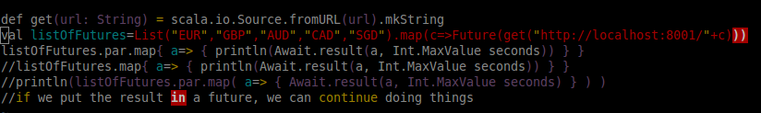
Example 3, parallel awaits
Await blocks the execution.
Await + parallel blocks each individual thread that runs in parallel

Slide 32
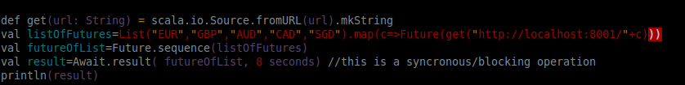
Convert list of futures to future of list
Example 4

Slide 33
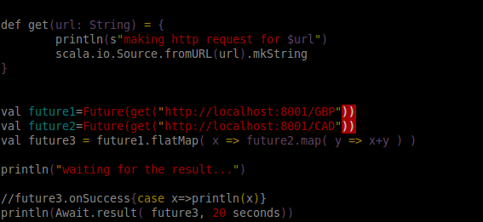
5, Flatmaps? Futures=Monads?
Example 5

Slide 34
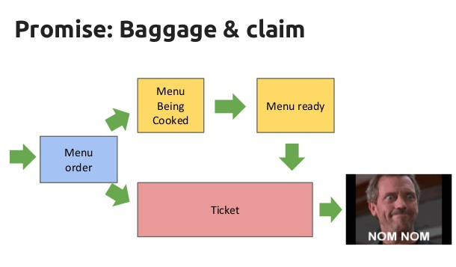
Promises

Slide 35
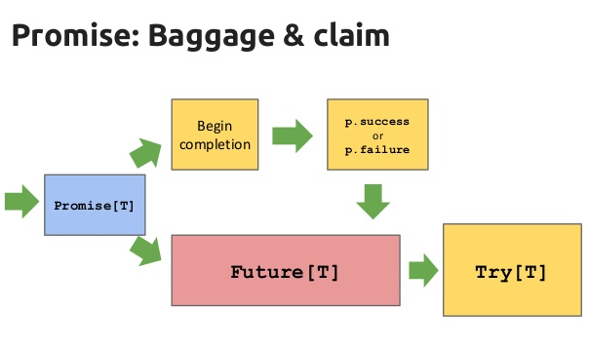
Promises

Slide 36
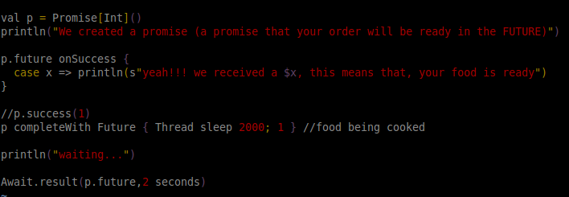
Promises

Slide 37


Want a beer?
Or you prefer to talk about Actors? ;-)

Slide 38
Let’s talk about Actors!
Actors… which actors?

Slide 39
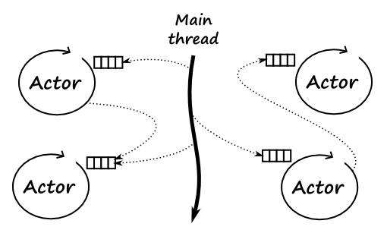

Slide 40
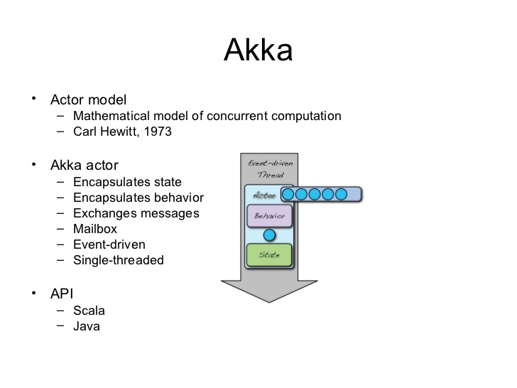
Actor Model

Slide 41
They are not just threads waiting for messages
They can reference each other by path:
Once you have your logic in a node, it is easily portable to a cluster.
val remoteFooActor = context.actorSelection("akka.tcp://actorSystemName@10.0.0.1:2552/user/fooActor")
Actor systems can detect new nodes in the cluster and trigger some actions…
Actors can supervise their children, detect when they throw an exception and do something about it (like restarting them).

Slide 42

Erlang for the JVM?
“If somebody came to me and wanted to pay me a lot of money to build a large scale message handling system that really had to be up all the time, could never afford to go down for years at a time, I would unhesitatingly choose Erlang to build it in”. Tim Bray, director of Web Technologies at Sun Microsystems
Erlang is:
Distributed
Fault-tolerant
Responsive/Reactive
Highly available (non-stop applications)
Allows Hot swapping
Who uses it?:
WhatsApp
RabitMQ
CouchDB
Facebook Chat
Ericson in GPRS and 3G mobile networks worldwide
T-Mobile for SMSs
…
Originally a proprietary language within Ericsson
Open source since 1998.

Slide 43
Implement the receive method
//Leverages the power of case statements
class Barista extends Actor { def receive = { case CappuccinoRequest => println("I have to prepare a cappuccino!") case EspressoRequest => println("Let's prepare an espresso.")
case n:Int => println("\nHello!"*n)
case "Hello" => println("HOLA")
case _ => println("???") } }

Slide 44
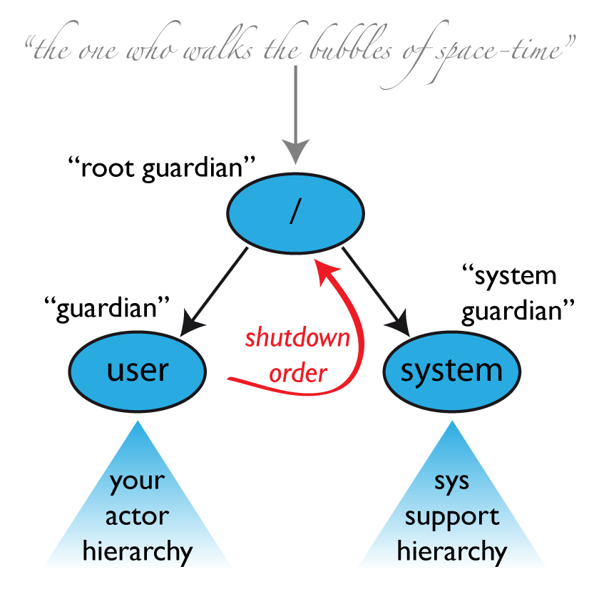
Supervision

Slide 45
Stopping or Killing Actors
Within an actor, you can stop a child actor by using the context reference:
context.stop(childActor)
An actor can also stop itself:
context.stop(self)
You can stop an actor by sending it a PoisonPill message:
actor ! PoisonPill
You can also kill actors:
actor ! Kill

Slide 46
Supervision Strategies
import akka.actor.Actor
class Supervisor extends Actor {
import akka.actor.OneForOneStrategy
import akka.actor.SupervisorStrategy._
import scala.concurrent.duration._
override val supervisorStrategy =
OneForOneStrategy(maxNrOfRetries = 10, withinTimeRange = 1 minute) {
case _: ArithmeticException => Resume
case _: NullPointerException => Restart
case _: IllegalArgumentException => Stop
case _: Exception => Escalate
}
def receive = {
case p: Props => sender() ! context.actorOf(p)
}
}

Slide 47
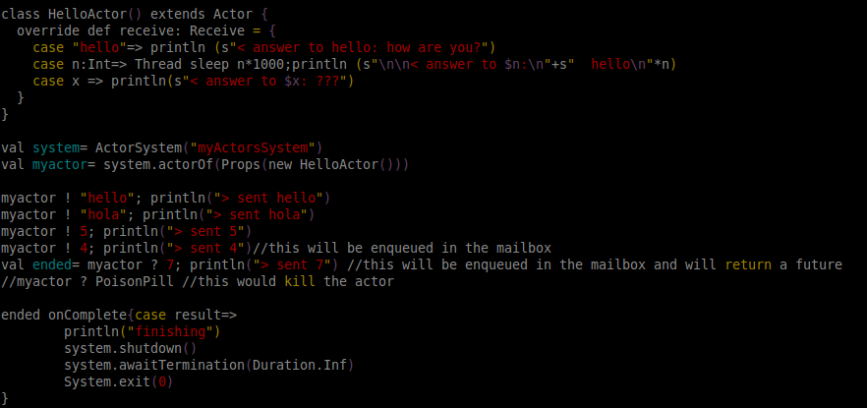
Examples 1 and 2
Example 2 : Ping Pong with actors

Slide 48
Example 5
We will only show the code if we have time

Slide 49
More buzzwords
Resilience / Fault Tolerance
One-For-One Strategy vs. All-For-One Strategy
Akka cluster
akka.routing
Special thanks to: Stackoverflow, Scalera.es, javaworld.com, github.com, Wikipedia...

Slide 50
END
Want a beer?
email: carlos.hernandez@liferay.com

